Slide 1
Krithi Krishna
BASICS PROGRAMMING CONCEPTS -

Slide 2
ALGORITHMS AND FLOWCHARTS
A typical programming task can be divided into two phases:
Problem solving phase
produce an ordered sequence of steps that describe solution of problem
this sequence of steps is called an algorithm
Implementation phase
implement the program in some programming language

Slide 3
Steps in Problem Solving
First produce a general algorithm (one can use pseudocode)
Refine the algorithm successively to get step by step detailed algorithm that is very close to a computer language.
Pseudocode is an artificial and informal language that helps programmers develop algorithms. Pseudocode is very similar to everyday English.

Slide 4
Pseudocode & Algorithm
Example 1: Write an algorithm to determine a student’s final grade and indicate whether it is passing or failing. The final grade is calculated as the average of four marks.

Slide 5
Pseudocode & Algorithm
Pseudocode:
Input a set of 4 marks
Calculate their average by adding and dividing by 4
if average is below 50
Print “FAIL”
else
Print “PASS”

Slide 6
Pseudocode & Algorithm
Detailed Algorithm
Step 1: Input M1,M2,M3,M4
Step 2: GRADE ← (M1+M2+M3+M4)/4
Step 3: if (GRADE < 50) then
Print “FAIL”
else
Print “PASS”
endif

Slide 7
FlowChart
START
Input
M1,M2,M3,M4
GRADE←(M1+M2+M3+M4)/4
IS
GRADE<50
N
Y
PRINT
“PASS”
PRINT
“FAIL”
STOP

Slide 8
Programming Languages & Translators
Types
High level language
Low level language
Assembly language
Language Translators:
Compiler
Interpreter
Assembler

Slide 9
Programming Constructs
Sequences
- tells the processor which statement is to be executed next
Selection
-branching of instructions(if, if-else, else-if ladder, switch etc.)
Repetition
-iteration or looping(for , while, do-while)

Slide 10
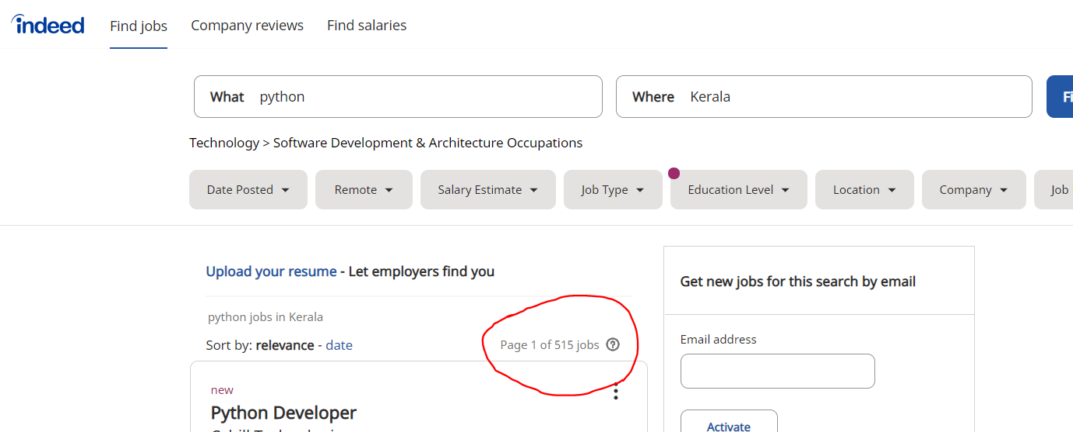
Why should you Learn Python ?

Slide 11
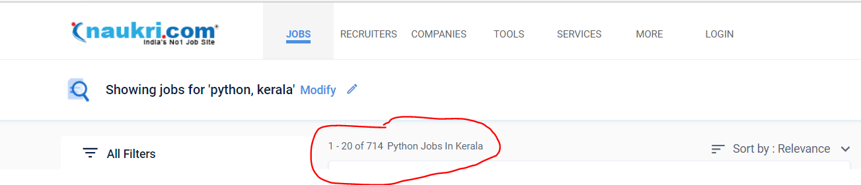
Why should you Learn Python ?

Slide 12
What is Python…?
Python is a programming language as well as a scripting language.
Python is also called as Interpreted language

Slide 13
History of Python
Invented in the Netherlands, early 90s by Guido van Rossum
Python was conceived in the late 1980s and
Implementation was started in December 1989
Open sourced from the beginning

Slide 14
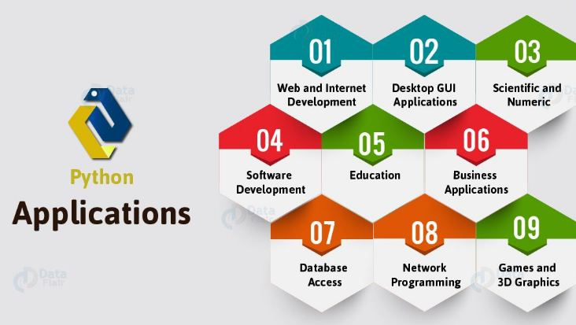
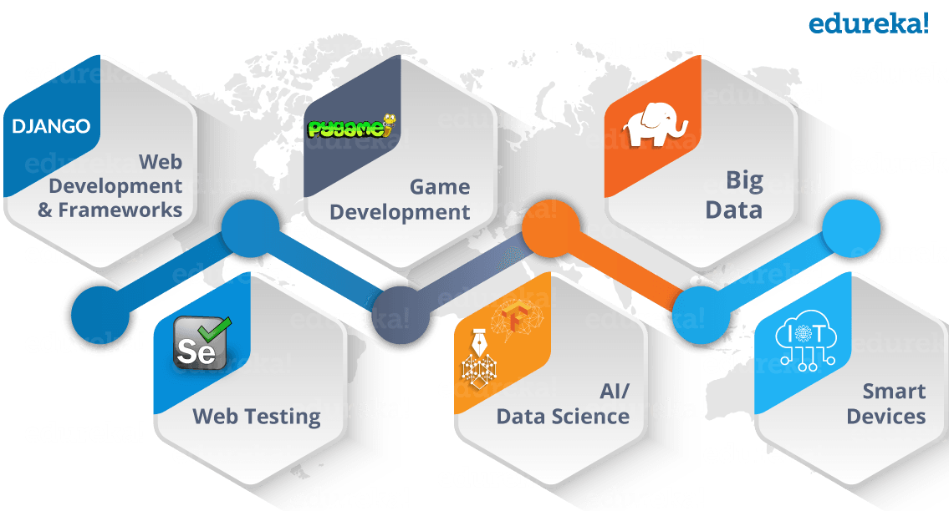
Scope of Python

Slide 15
Why do people use Python…?
Python is object-oriented
It's free (open source)
Indentation
It's powerful
Dynamic typing
Built-in types
Library utilities - Third party utilities (e.g. Numeric, NumPy, SciPy)
Automatic memory management

Slide 16
Why do people use Python…?
It's portable
It's easy to learn
It's easy to use - No intermediate compile and link steps as in C/ C++
It's mixable - Python can be linked to components written in other languages easily

Slide 17
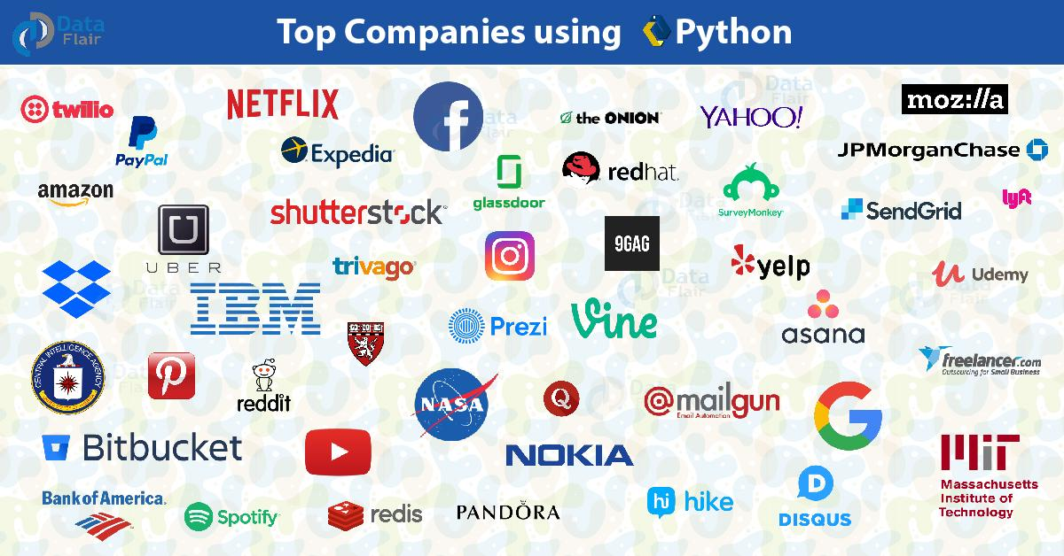
Who uses python today?

